Slide 1
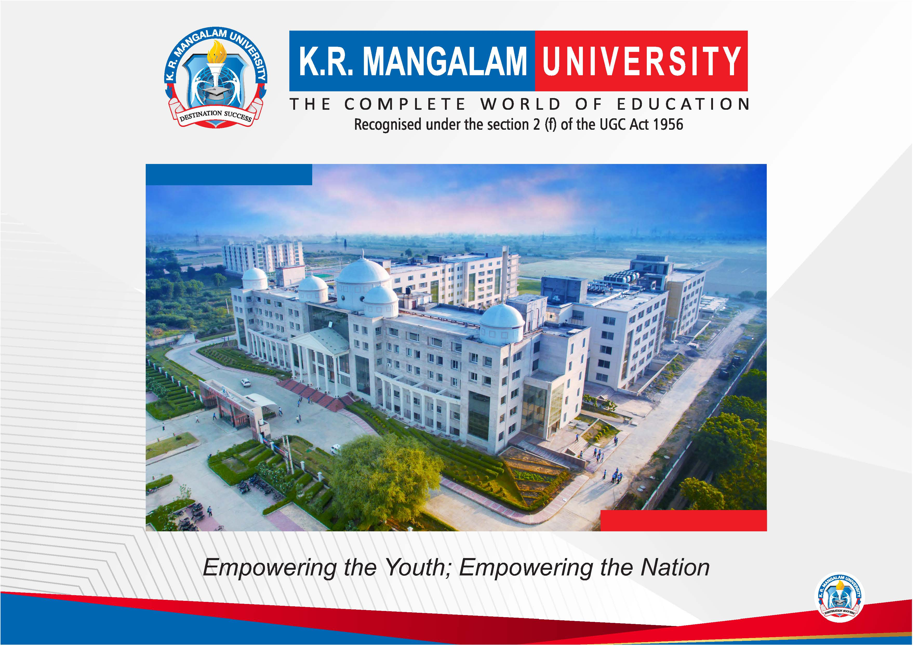

Slide 2


Smart Chatbot for College Queries
Second Year Project Synopsis
Submitted by
ROLL | NAME
2301730318 | VANSHIKA BHARDWAJ
2301730292 | TAHA JAMAL
2301730342 | RAKSHIT SACHDEVA
Industry Mentor: MAHIMA BHARDWAJ
Faculty Mentor: NEETU CHAUHAN
Notes:
New Courses replaced with New Programmes

Slide 3
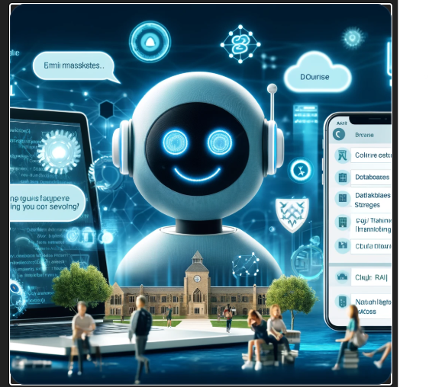

Project Overview
The Smart College Query Chatbot is an AI-powered assistant designed to help students, faculty, and parents with common college-related questions. It provides instant responses to queries about admissions, courses, faculty, events, library services, and more, reducing the need for manual assistance.
To reduce the workload of administrative staff.
To provide instant and accurate answers to frequently asked questions.
To integrate with a website or messaging platform for ease of use.
Notes:
New Courses replaced with New Programmes

Slide 4
About the Problem
Develop a smart chatbot that can provide instant and accurate responses to common college-related queries.
Students frequently ask about admission procedures, course details, fee structure, exam schedules, etc.
Staff must answer the same questions again and again, which is time-consuming.
Information given over phone or email may be inconsistent or incomplete.
Important information may not reach students in time.
Students may have doubts outside college hours.
Understand and respond to text-based queries in real time.
There's no system to support them instantly at night, during holidays, or in emergencies.
To Develop smart chat bot.
To integrate the chatbot into college platforms.
Notes:
New Courses replaced with New Programmes

Slide 5
Problem Statement
"In many colleges, students face difficulties in obtaining timely and accurate responses to their academic and administrative queries due to limited staff availability, high query volume, and inefficient communication channels. This leads to confusion, missed deadlines, and poor student experience.“
This project aims to develop an AI-driven chatbot that can provide
real-time.
accurate answer.
intelligent responses to student inquiries,
reducing the dependency on human intervention.
Notes:
New Courses replaced with New Programmes

Slide 6
Objectives
The chatbot will be developed with the following objectives:
To develop an intelligent virtual assistant capable of handling college-related queries.
To answer frequently asked questions related to admissions, courses, fees, exams, etc, without human intervention.
To provide round-the-clock support to students, parents, and prospective applicants.
To respond based on user profiles such as prospective students, current students, or alumni.
To deliver instant, precise, and consistent responses across different topics.
To implement NLP algorithms that improve chatbot understanding of student queries.
To automate repetitive administrative tasks, reducing human workload.
To provide 24/7 accessibility, ensuring students get answers anytime.
To improve response accuracy through AI-based learning techniques.
To integrate the chatbot into college platforms (website, mobile app, etc.).
Notes:
New Courses replaced with New Programmes

Slide 7
Methodology, Tools, and Techniques
To develop this chatbot, the following technologies and tools are used:
Programming Language: Python (for backend processing and chatbot logic).
Web Framework: Flask.
Development Environment: Visual Studio Code (VS Code).
Natural Language Processing (NLP): Used for understanding and generating responses.
Deployment Platform: The chatbot may be integrated into a website, mobile application, or messaging platform.
Notes:
New Courses replaced with New Programmes

Slide 8
Methodology Flowchart
Step 1: Requirement Analysis
Identify the most common student queries related to college administration.
Step 2: Data Collection & Processing
Train the chatbot on real student queries for better understanding.
Step 3: NLP Implementation
Use NLP techniques to process and interpret user queries
Step 4: Backend Development
Develop the chatbot logic using Python.
Step 5: Testing & Optimization
Test the chatbot’s response accuracy.
Step 6: Deployment & Integration
Ensure seamless integration with existing platforms.
Notes:
New Courses replaced with New Programmes

Slide 9
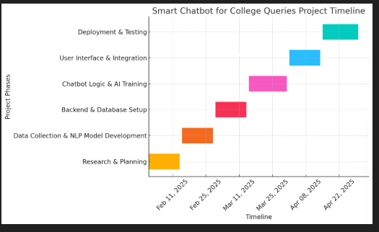
Project Timeline
Gantt chart or timeline graph
Phase1: Research& Planning week 1-2
Phase 2: Data Collection & NLP Model Development week 3-4
Phase 3: Backend & Database Setup week 5-6
Phase 4: Chatbot Logic & AI Training week7-8
Phase 5:User Interface & Integration week 9-10
Phase 6: Deployment & Testing week 11-12
Notes:
New Courses replaced with New Programmes

Slide 10
Expected Results & Impact
Expected Results:
Chatbot will help automate responses to common questions about college life, courses, deadlines, etc.
A well-designed smart chatbot can indeed solve the identified problem if it’s tailored to meet the specific needs of the user.
Impact:
Through this chatbot it can make several valuable contribution to it’s field in specifically in terms of user experience.
It assist the education institute to automate all queries.
Yes, the future scope of this project is as in education and in technology.
Notes:
New Courses replaced with New Programmes

Slide 11
References
"BERT: Pre-training of Deep Bidirectional Transformers for Language Understanding" by Jacob Devlin et al.
"Building Chatbots with Python: Using Natural Language Processing and Machine Learning" by Sumit Raj (Book-based research paper)
"Speech and Language Processing" by Daniel Jurafsky and James H. Martin
"Deep Learning with Python" by François Chollet and many more.
Notes:
New Courses replaced with New Programmes

Slide 12
THANK YOU

